Slide 1
UNDERSTANDING THE ISSUES OF MULTICULTURALISM : How Indonesia Takes Steps to Include Different Ethnicities in Its Policies
Mega Hidayati
Universitas Muhammadiyah Yogyakarta

Slide 2
DEFINITION
"Multiculturalism is clearly beyond toleration and state neutrality for it involves active support for cultural difference, active discouragement against hostility and disapproval, and the remaking of the public sphere to fully include marginalized identities,” (Modood, 2010)
"governmentality" aimed at resolving conflicts and tensions brought on by racial, ethnic, and cultural differences. (Foucault)

Slide 3
ISSUES OF OBJECTION
"the '-ism' tends to convert ‘multiculturalism’ into a political doctrine” (Stuart Hall)
A single ‘ism’
Single idea (Vertovec & Wessendorf)

Slide 4
Promoting social equality
Acknowledgement of cultural differences
Convergency of policy
Counteracting racist hegemony
MULTICULTURALISM
Policy for embracing diverse races
Active support for cultural diversity

Slide 5
EDUCATION
SOCIAL SERVICE
PUBLIC ACKNOWLEDGEMENT
PUBLIC DOCUMENTS
WAYS OF MULTICULTURALISM
RELIGIOUS ACCOMODATION
BROADCASTING
MEDIA
FOOD

Slide 6
INDONESIA

Slide 7
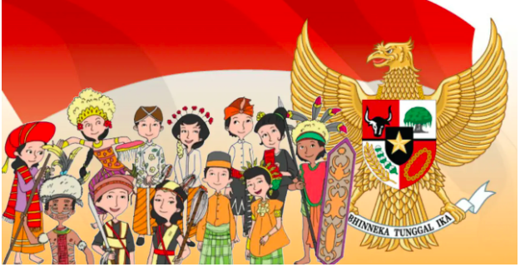
INDONESIA
300 ethnic groups with their own languages
1,340 ethnicities
Pancasila as the Foundation
Slogan
Bhinneka Tunggal Ika (Unity with diversity)
satu nusa, satu bangsa dan satu bahasa (one homeland, one nation, and one language)
Javanese, Bataknese, Sundanese, Malay, Madurese, Dayak, Bugis, Minang, Betawi, etc

Slide 8
TAKES STEP FOR FORMULATING MULTICULTURALISM IN POLICIES: SOME EXAMPLES

Slide 9
THE NATIONAL PLAN IN CULTURAL DEVELOPMENT
Pillars of Developing Culture
One of the Pillars is “strengthening multiculturalism”

Slide 10
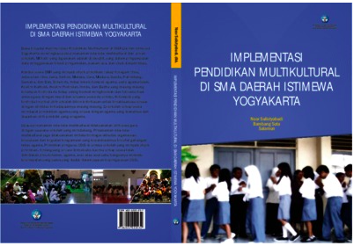
EDUCATION
“Implementation of civic education through social organizations that are oriented towards strengthening national insight among citizens in order to strengthen national identity through an understanding of the values of multiculturalism and respect for social pluralism.”
(Ministry of Education and Culture regulations, 2015)

Slide 11
HEALTH
“respect multicultural culture regarding patient health”
Decree of the Minister of Health of the Republic of Indonesia concerning the Professional Standards of Anesthesiologists

Slide 12
BROADCASTING
“Broadcasting Program Standards are directed in order to have broadcast programs whi:
c. Respect and uphold the norms and values of the nation's multicultural religion and culture.”

Slide 13
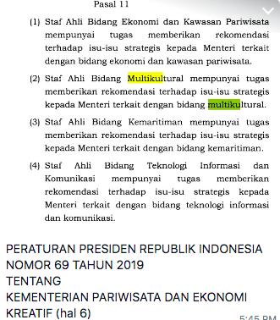
TOURISM
“Expert staff in the multicultural sector have the task of providing recommendations on strategic issues to the Ministers related to the multicultural sector.”
The President’s Regulation no. 69, 2019 on the Ministry of Tourism and Creative Economy

Slide 14
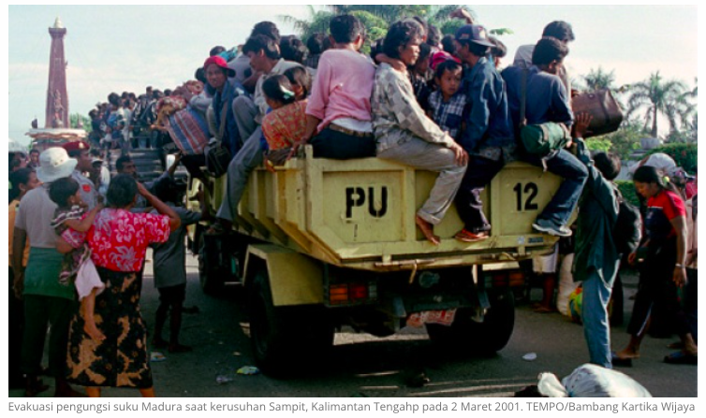
Crisis example of Ethnics Conflict in Indonesia
the New Order regime (1965-1997) prohibited public discussions on issues of SARA (Suku, Agama, Ras dan Antar-golongan or Ethnic Group, Religion, Race and Inter Group).
violent conflicts :
the Dayak-Madurese in Kalimantan in December 1996/January 1997 (600 died)
the Dayak-Madurese in Kalimantan in February, 2001 (500 people died, more than 100,000 Madurese lost their homes)

Slide 15
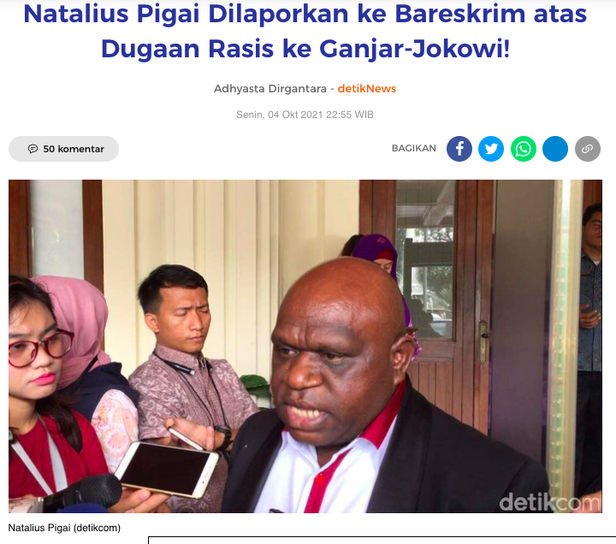
Example of Case
Natalius Pigai (The former Commissioner of the National Human Rights Commission)
"Don't believe the people of Central Java, Jokowi & Ganjar. They robbed us of our wealth, they killed the people of Papua, trampled on the dignity of the Papuan people with lowly words, racism, monkeys and trash. We are not lowly. We fight injustice to the last drop of blood. I am against injustice.” (in tweeter)

Slide 16
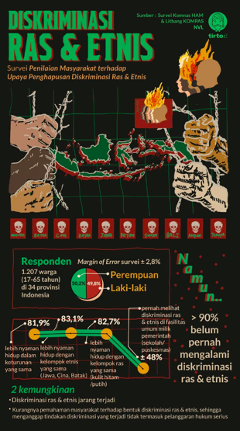
National Human Rights Commission’s Survey
1.207 respondent in 34 provinces
82.7 %: more comfortable living in the same race environment.
83.1 %: more comfortable living with the same ethnic group.
51.2 %:have seen discriminatory writings and pictures in government-owned public facilities.
58.5 percent have heard discriminatory speeches, expressions, and words.
39.2 percent saw people wearing attributes in the form of objects, words or images that were discriminatory
43.2 percent saw people or groups taking people's lives, molestation, rape, obscene acts, violent theft, or deprivation based on race and ethnicity in the government's public facilities.
Komnas HAM recorded at least 101 cases of racial and ethnic discrimination in the 2011-2018 period that were reported to them.
These violations include restrictions on public services, rampant ethnicity or identity politics, disbandment of traditional rituals, discrimination on land ownership rights for minority groups, and unfair employment access.

